Slide 1
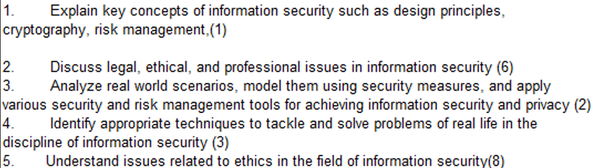
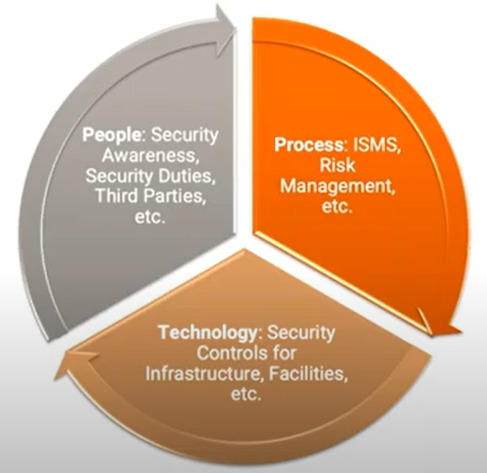
CS 3002 Information Security
Fall 2025
Week # 1 – Lecture # 1, 2, 3
Ms. Hira Tunio

Slide 2
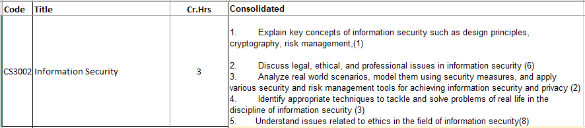
InfoSec CLOs and Course outline

Slide 3
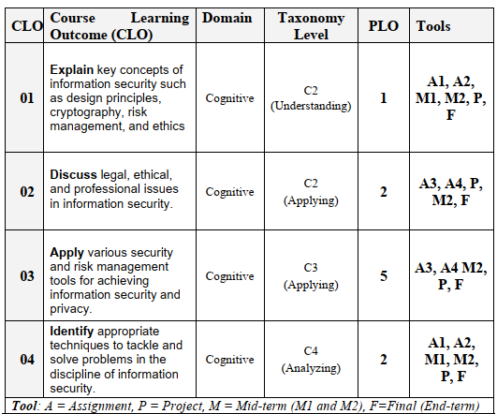

Slide 4
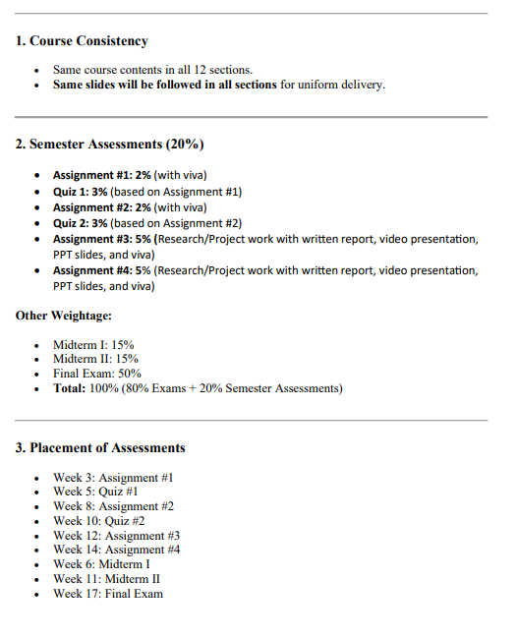

Slide 5
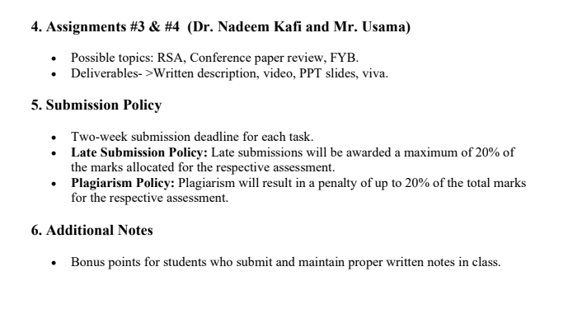

Slide 6
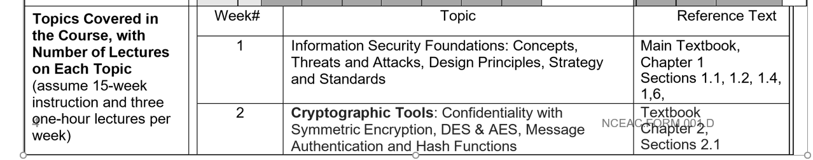
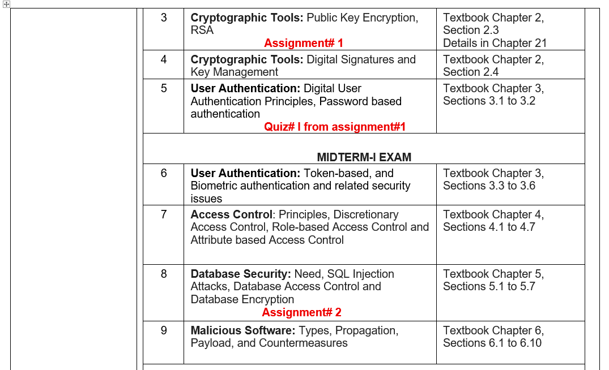

Slide 7
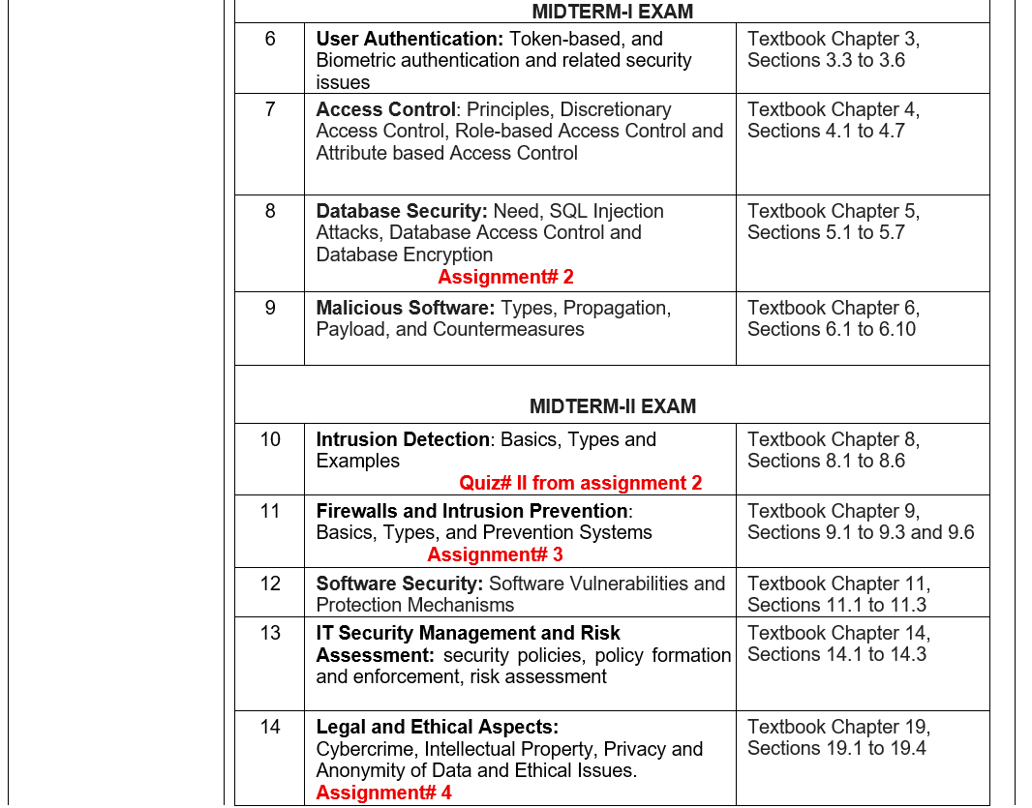

Slide 8
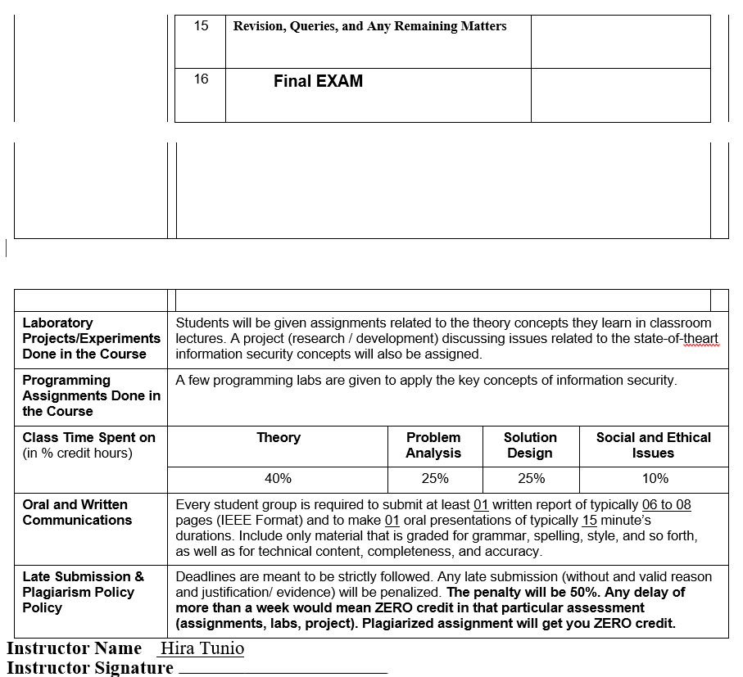

Slide 9
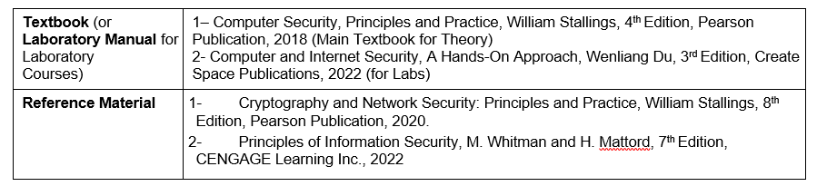
Notes:
case study of companies their vulnerability & risk assessment e.g Bank, draz etc

Slide 10
Important notes
No re-quiz will be entertained
Late submission and plagiarism policy will strictly be followed
Make notes during the lecture it will be considered as a class participation

Slide 11
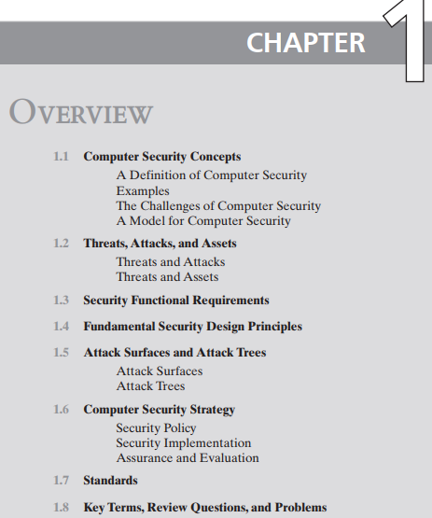
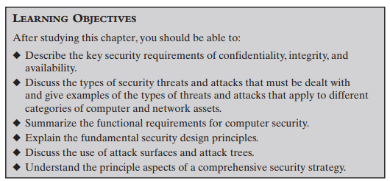


Slide 12


Notes:
NIST-National Institute of Standards and Technology

Slide 13
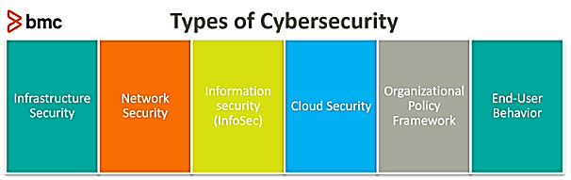
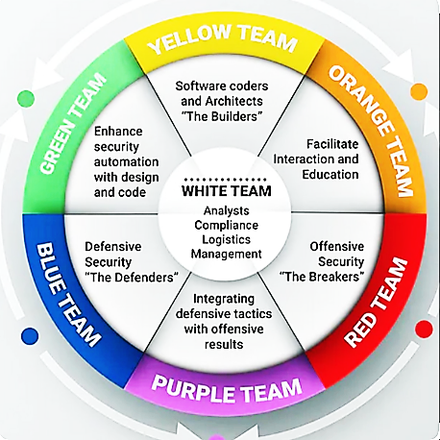
Information security
Infrastructure Hardware (CPU + Box)
Application Security
OS security
Network Security (Router, Switches, + Boxes)
Notes:
Network Security: measures such as encryption, traffic monitoring, firewalls, Virtual Private Networks (VPNs), and end-point security ensure data integrity as it transmits between servers and clients across distributed networks. Information Security: Are designed to ensure that only the authorized users, apps, and systems are able to access the required information.
Cloud Security: ensures that this infrastructure and the data stored in cloud systems is secure against cyber threats.
Organizational policy framework: is the part of cybersecurity responsible for mitigating security risks.
End-Users: are the first line of defense against cyber-attacks. Many security vulnerabilities in technologies and systems can be addressed by controlling the human element compromised with a cyber-attack. Endpoint security helps protect end-user endpoints such as laptops, desktops, smartphones, and tablets against cyberattacks.

Slide 14
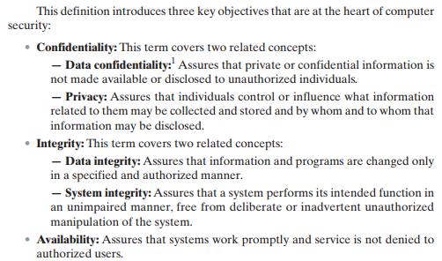
Notes:
Unimpaired*=not damaged
Deliberate*=for purpose
Inadvertent*=unplanned

Slide 15
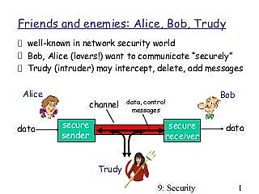

Slide 16
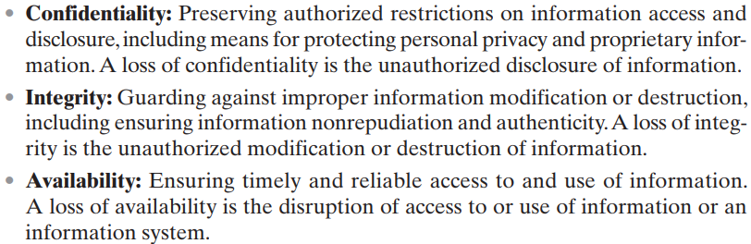

Slide 17
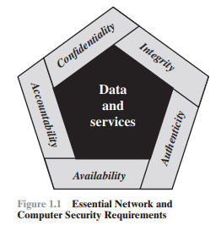
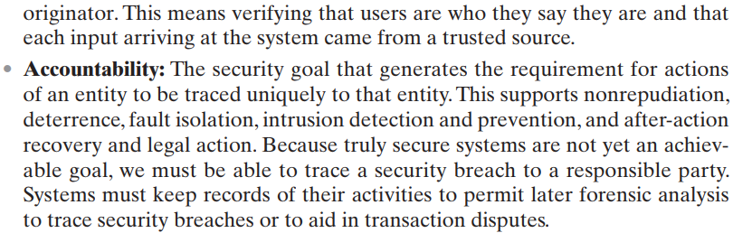
Two additional concepts are needed to present a complete picture
Low
Moderate
High
FIPS (Federal Information Processing Standards)

Slide 18
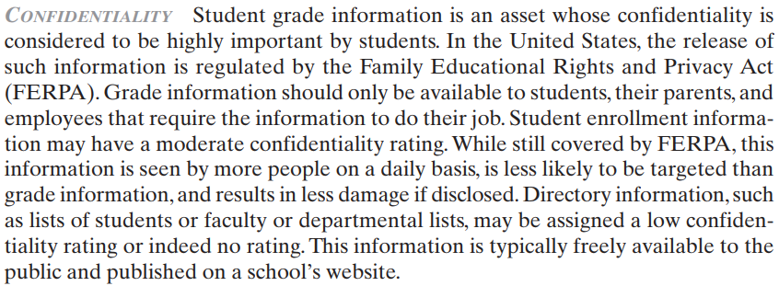
Real World Examples: Confidentiality, Integrity and Availability
Impact of Risk:
Low
Moderate
High

Slide 19
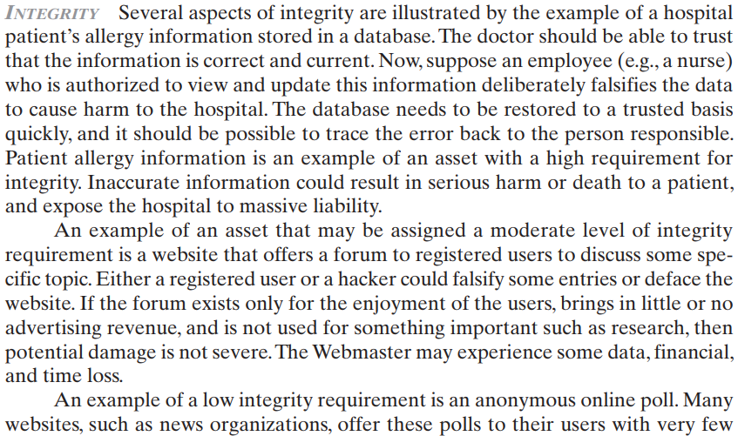
Real World Examples: Confidentiality, Integrity and Availability

Slide 20
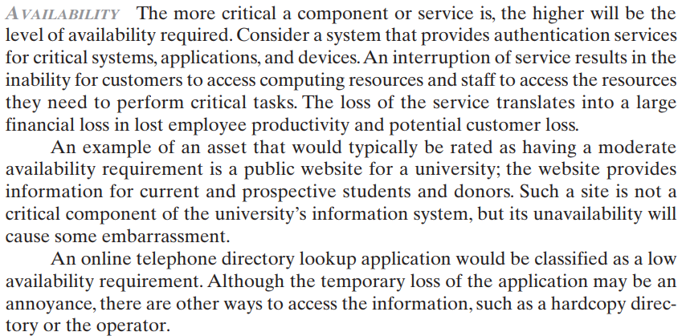
Real World Examples: Confidentiality, Integrity and Availability

Slide 21
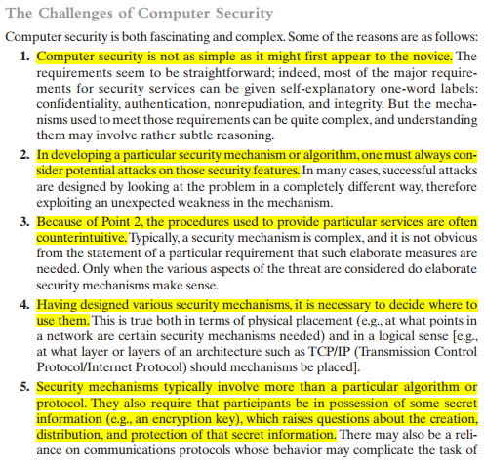
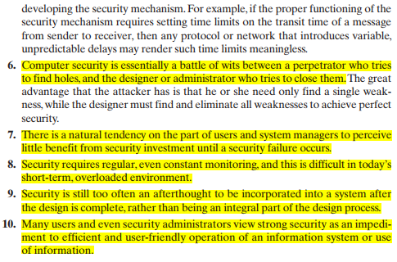
Notes:
Novice=beginner
Counterintuitive = illogical or faulty

Slide 22
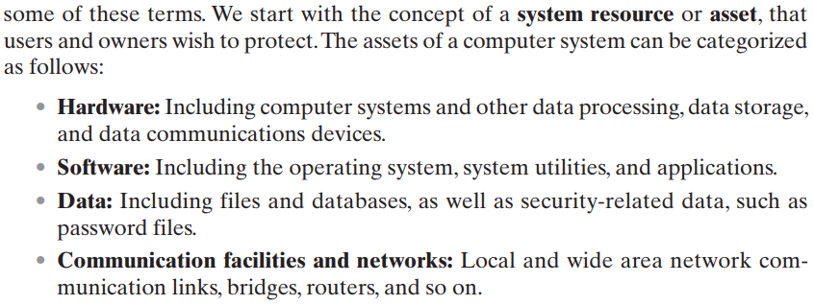

Slide 23
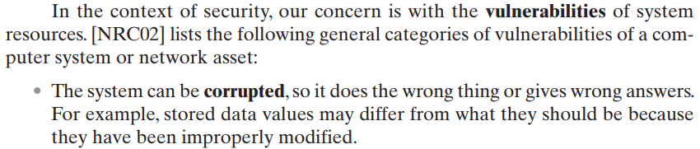
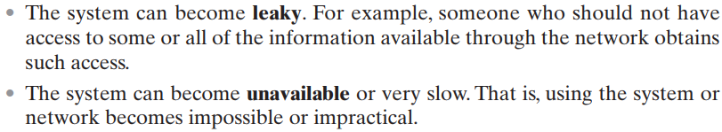

These three types of vulnerability correspond to the concepts of integrity, confidentiality, and availability

Slide 24
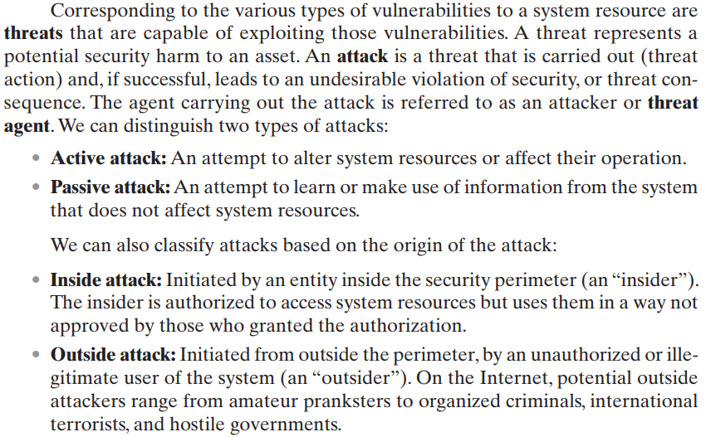
Active Attack: harm for Integrity as well as Availability.
e.g: DoS attack
Active Attack is dangerous for Integrity as well as Availability.
Passive Attack: harm for Confidentiality.
E.g Sniffing

Slide 25
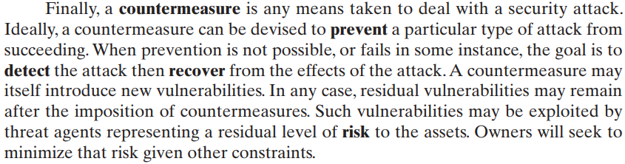

Slide 26
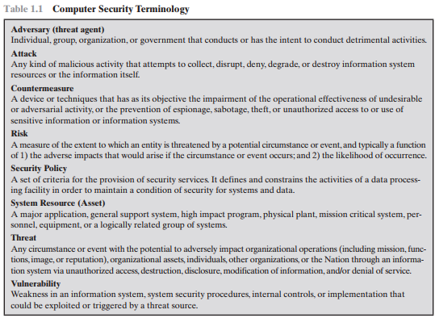
Notes:
Detrimental→ Harmful activities
Sabotage → destroy for some advantage
Espionage → spy or undercover work
First, a vulnerability exposes your organization to threats.
A threat is a malicious or negative event that takes advantage of a vulnerability.
Finally, the risk is the potential for loss and damage when the threat does occur.

Slide 27
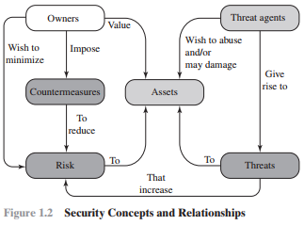

Slide 28
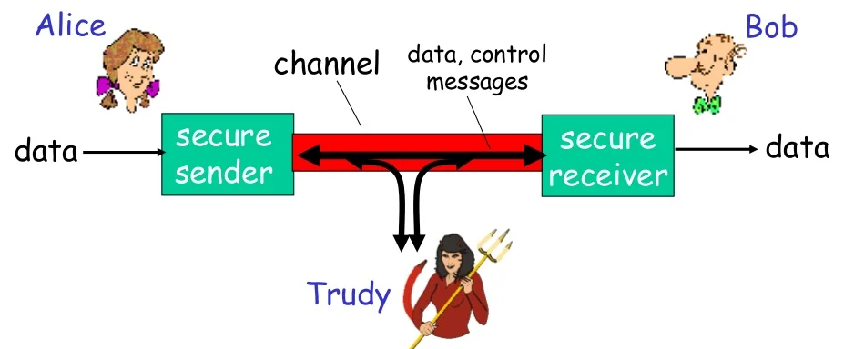

Slide 29
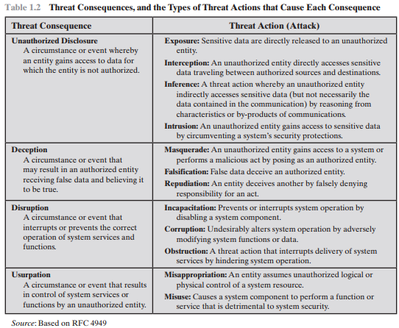

Slide 30
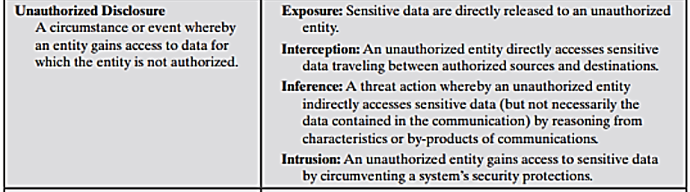
Types of attacks can result in this threat consequence:

Slide 31
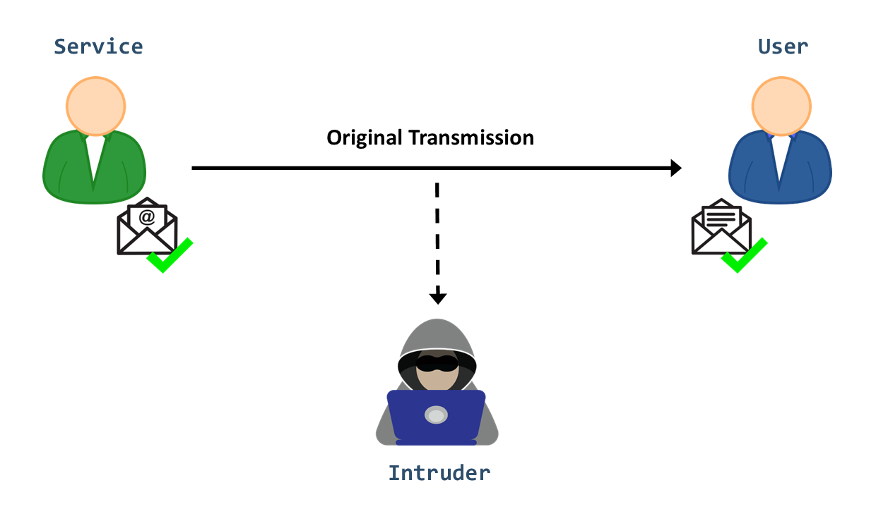
Exposure: This can be deliberate, as when an insider intentionally releases sensitive information
such as credit card numbers, to an outsider. It can also be the result of a human, hardware, or software error
Example: Universities accidentally posting confidential student information on the Web.
Interception: Interception is a common attack in the context of communications.
Example: On a shared LAN, such as a wireless LAN or a broadcast Ethernet, any device attached to the LAN can receive a copy of packets intended for another device.
On the Internet, a determined hacker can gain access to e-mail traffic and other data transfers.
All of these situations create the potential for unauthorized access to data.
Inference: The ability of authorized user to deduce information from observing authorized information
Example: Inference is known as traffic analysis, in which an adversary is able to gain information from observing the pattern of traffic on a network, such as the amount of traffic between particular pairs of hosts on the network.
Another example is the inference of detailed information from a database by a user who has only limited access; this is accomplished by repeated queries whose combined results enable inference.
Intrusion: Intrusion is an adversary (attacker) gaining unauthorized access to sensitive data by overcoming the system’s access control protections i-e unauthorized login
Example: Trying to get access with different logins and passwords

Slide 32
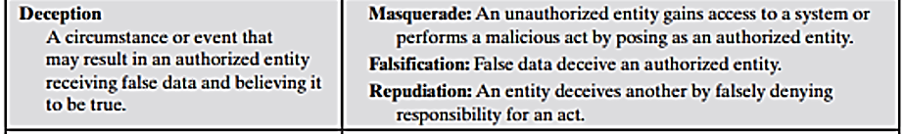
Masquerade: One example of masquerade is an attempt by an unauthorized user to gain access to a system by posing as an authorized user; this could happen if the unauthorized user has learned another user’s logon ID and password.
Another example is malicious logic, such as a Trojan horse, that appears to perform a useful or desirable function but actually gains unauthorized access to system resources, or tricks a user into executing other malicious logic.
Falsification: This refers to the altering or replacing of valid data or the introduction of false data into a file or database.
For example: a student may alter his or her grades on a school database.
Repudiation: a user either denies sending data, or a user denies receiving or possessing the data.
For example: An example of a repudiation attack might be someone accessing your e-mail server and sending inflammatory information to others. This information can prove embarrassing to you or your company if this happens.

Slide 33
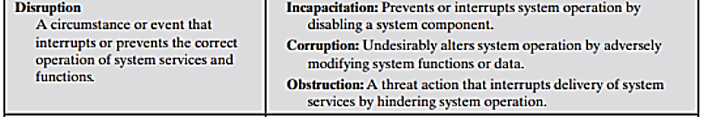
Incapacitation: This is an attack on system availability. This could occur as a result of physical destruction of or damage to system hardware.
Example: Malicious software, such as Trojan horses, viruses, or worms, could operate in such a way as to disable a system or some of its services.
Corruption: Malicious software in this context could operate in such a way that system resources or services function in an unintended manner. Or a user could gain unauthorized access to a system and modify some of its functions
Example: a user placing backdoor logic in the system to provide subsequent access to a system and its resources by other than the usual procedure e.g Ransome
Obstruction: One way to obstruct system operation is to interfere with communications by disabling communication links or altering communication control information. Another way is to overload the system by placing excess burden on communication traffic or processing resources.

Slide 34
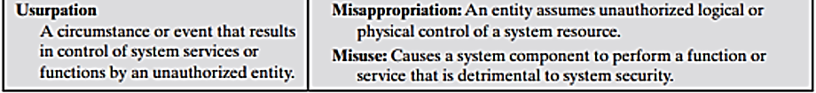
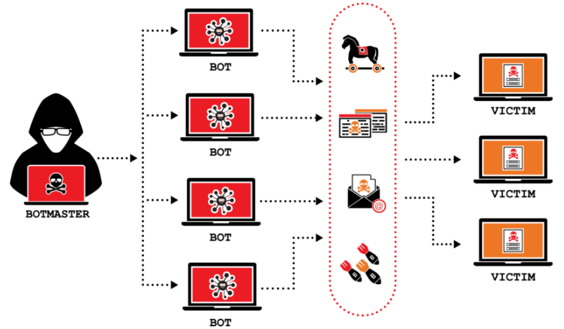
Misappropriation: This can include theft of service.
Example: is a distributed denial of service attack, when malicious software is installed on a number of hosts to be used as platforms to launch traffic at a target host. In this case, the malicious software makes unauthorized use of processor and operating system resources.
Misuse: Misuse can occur by means of either malicious logic or a hacker that has gained unauthorized access to a system. In either case, security functions can be disabled or thwarted.
Example: Antivirus is disable attacker can attack computer.

Slide 35
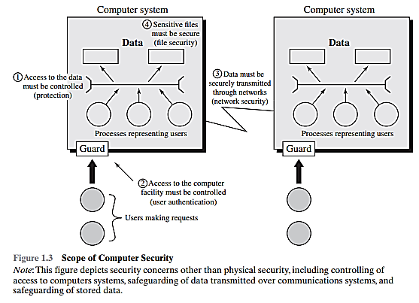
[1] Access to the data must be controlled (protection)
[2] Access to the computer facility must be controlled (user authentication)
[3] Data must be securely transmitted through networks (network security)
[4] Sensitive files must be secure (file security)
Physical Security
OS Security
Application
Social Engineering

Slide 36
